Slide 1


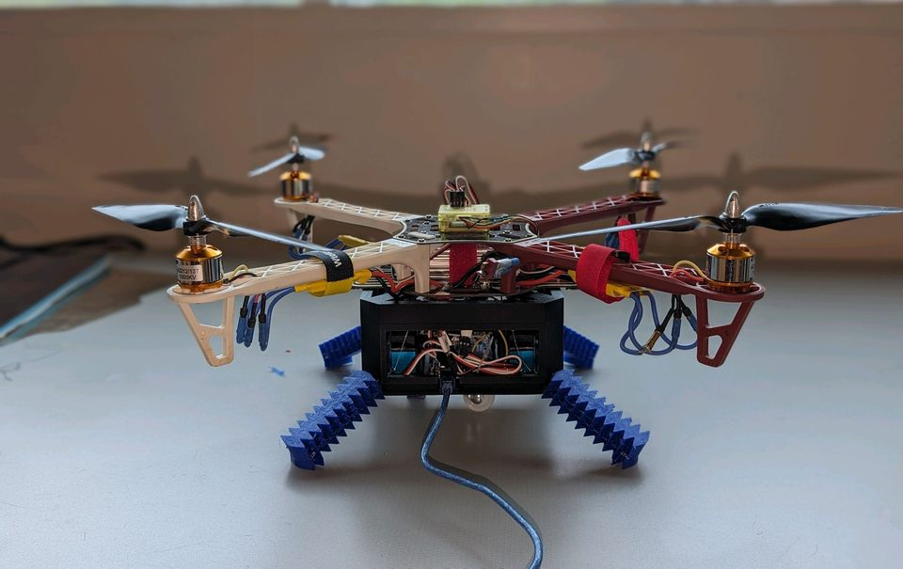
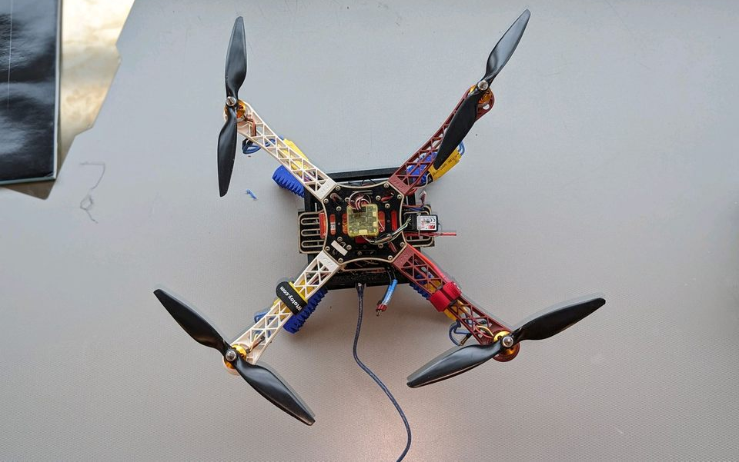
Robotic Drone Navigation in Complex Terrain’s For NASA’s Space Exploration
Thomas Brown, Solomon Fleury, Christine-Marie Lirazan
Mentors: Dr. Turaj Ashuri and Dr. Amir Ali Amiri
Southern Polytechnic College of Engineering and Engineering Technology
Introduction
Results
This research aims to create a new type of hybrid quadruped walker-drone featuring 3D-printed soft legs designed for navigating Mars' rugged terrain. The proposed robot’s ability to traverse sandy environments and explore confined spaces, such as caves, offers unprecedented opportunities for scientific discovery and resource exploration on Mars.
The hybrid robot can operate by flying from the quadcopter and walking from the quadruped legs—enabling both aerial and ground exploration.
The walking function of the hybrid robot serves as a form of graceful degradation, enabling continued mobility when flying is impractical or restricted.
Methodology
Conclusions
Existing literature concerning drone technology for space exploration and soft robotics was analyzed to guide the design process and identify main challenges and opportunities.
Designs for the hybrid robot were developed using SolidWorks.
The frame was printed with PLA filament and the soft legs and fins were printed with TPU filament.
The walking and flying mechanisms were programmed utilizing Arduino IDE.
Four servos rotate to tighten the four attached strings, inducing lateral movement in each leg, thus forming the walking mechanism.
The hybrid robot utilizes four brushless motors for flying.
Figure 1 – Fully Assembled Hybrid Drone-Walker.
The final design of this research is a hybrid drone-walker robot with infinite degrees of freedom—not possible for contemporary hybrid aerial and ground vehicle designs that utilize wheels.
Future Research
Areas for further research include improving attachment systems, enhancing leg flexibility and range of motion, and refining control algorithms to maximize efficiency and adaptability in diverse terrains.
Acknowledgments
We thank Kennesaw State University's Office of Undergraduate Research and the First Year Scholars Program for providing the opportunity and funding necessary for us to carry out this research.
Figure 2 – Aerial view of the framework for the flying mechanism.

